Slide 1


Banded Bariatric Surgery: an Update
Paolo Gentileschi, Professor of Surgery, University of Rome Tor Vergata
Bariatric and Metabolic Surgery Unit, Chief
IRCCS Maria Cecilia Hospital, GVM Care & Research, Cotignola (Ravenna)

Slide 2
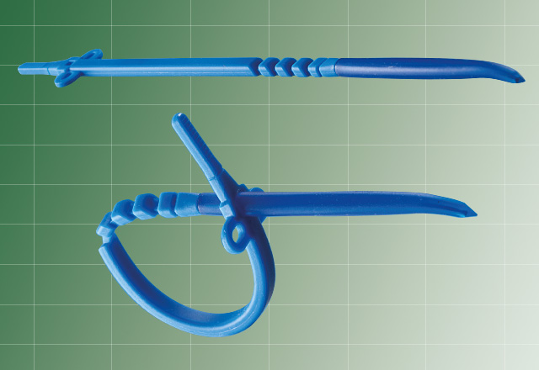
Banded procedures with the Ring MiniMizer

Slide 3

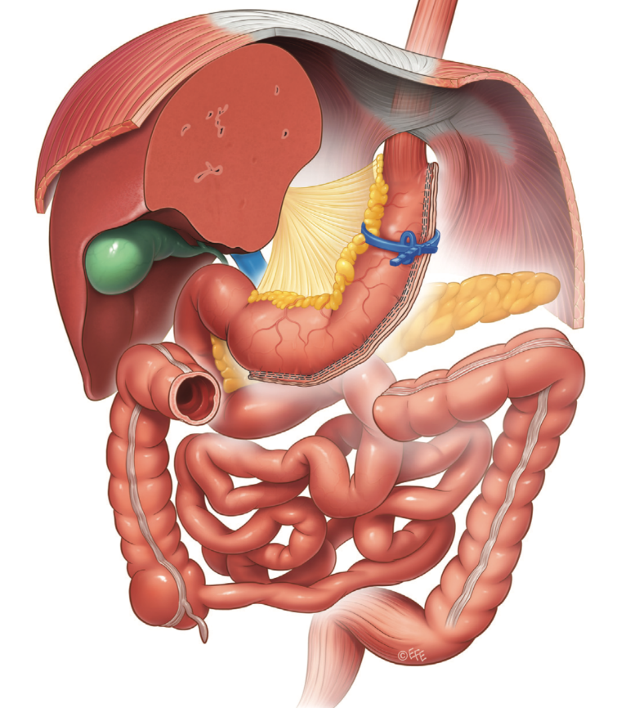
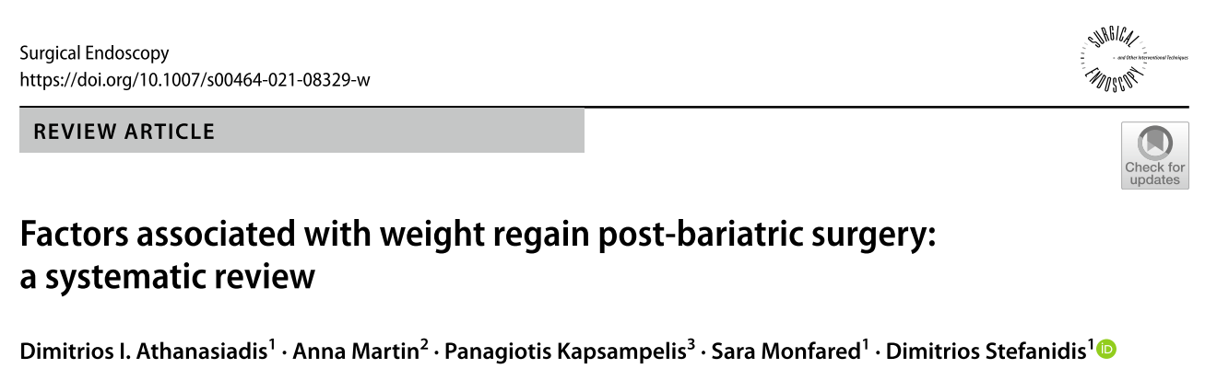
Banded sleeve: rationale
Incidence of weight regain was 17.6% (n = 2314/13,152; 95% CI 16.9–18.3).

Slide 4
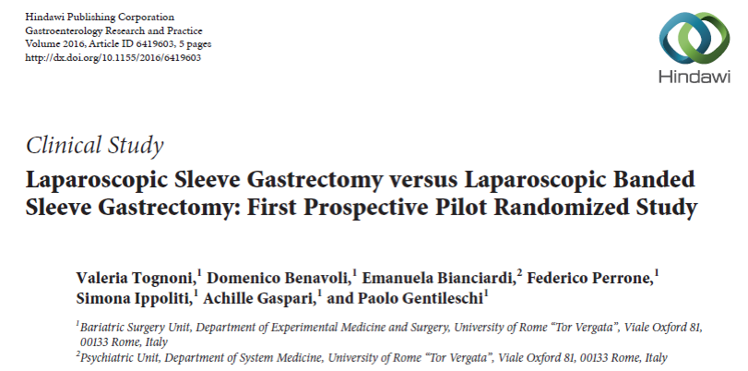
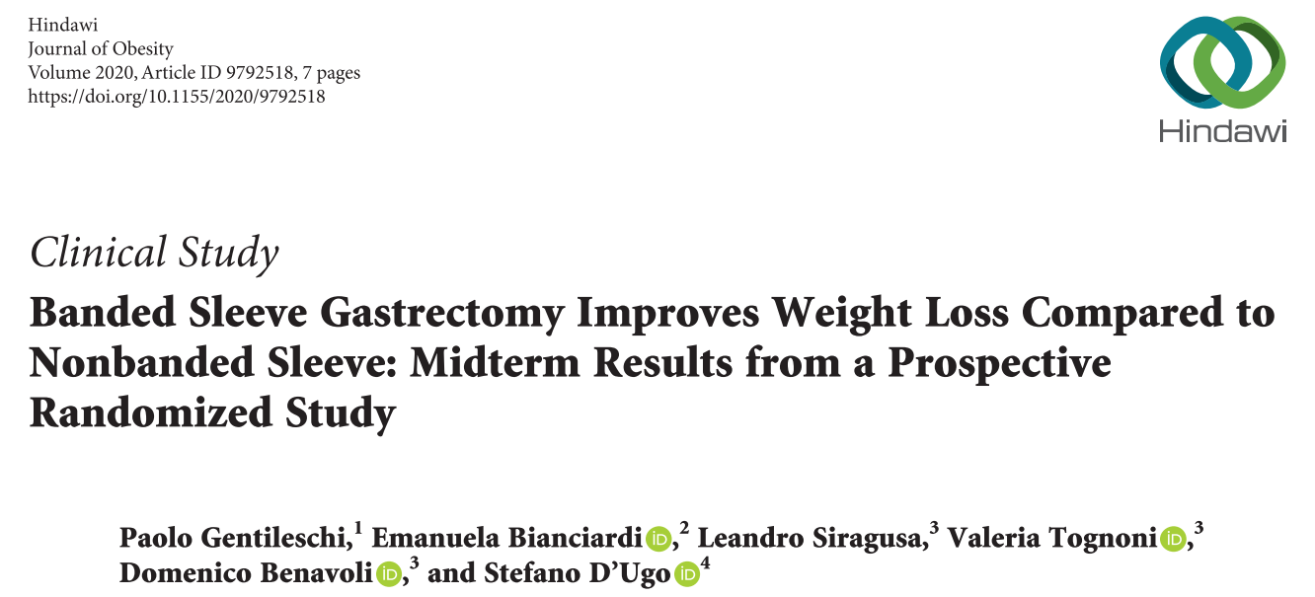
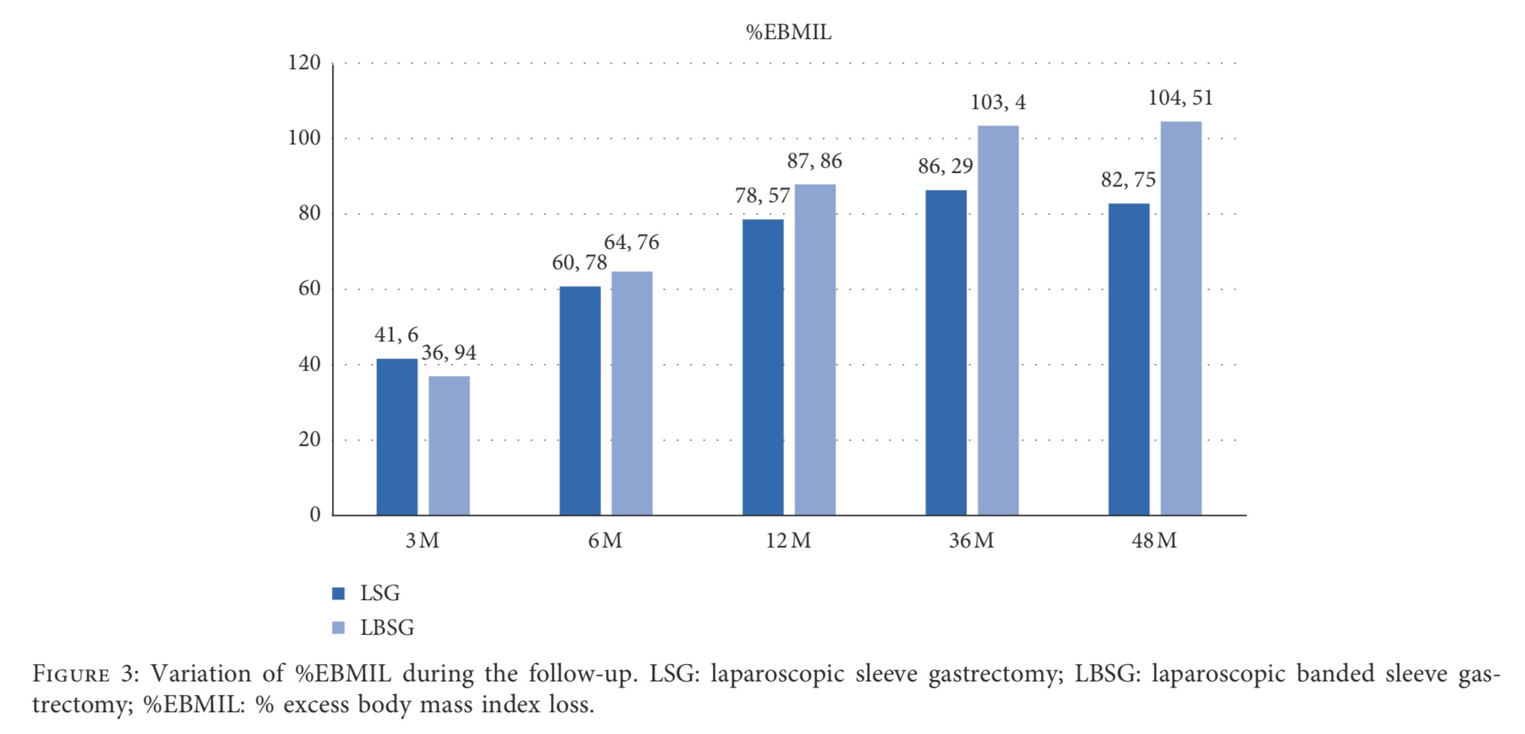
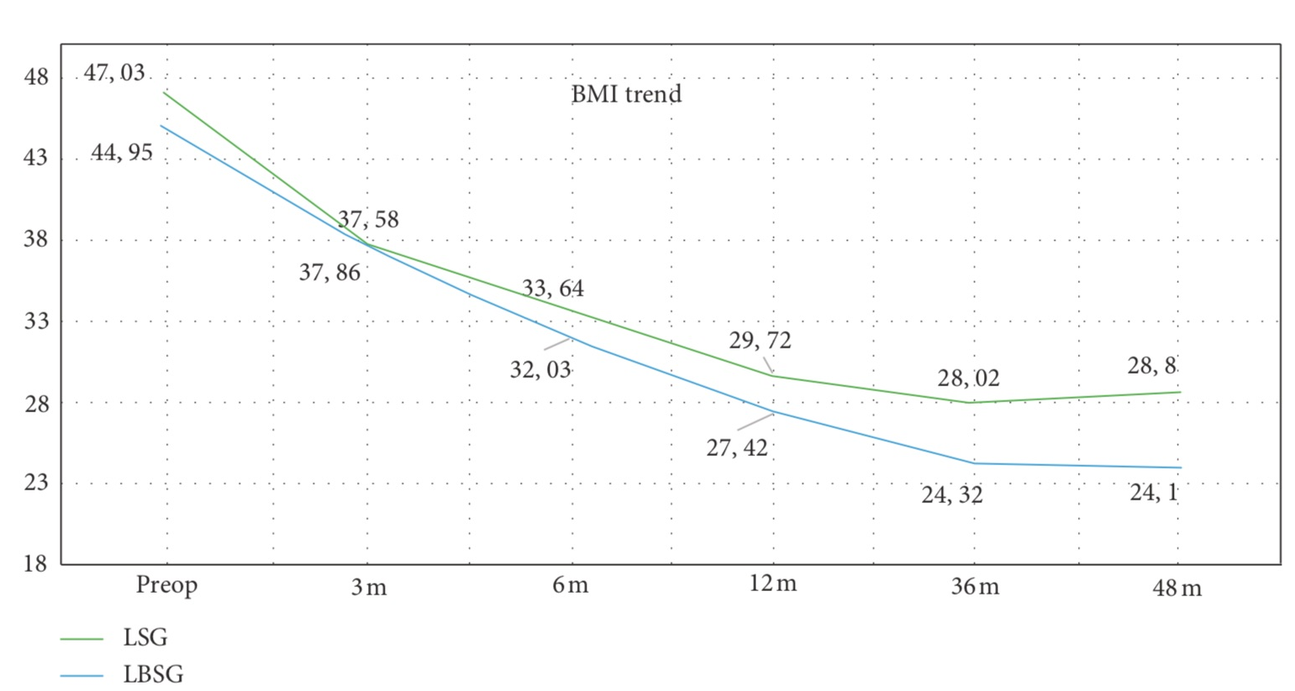

Banded sleeve: results

Slide 5
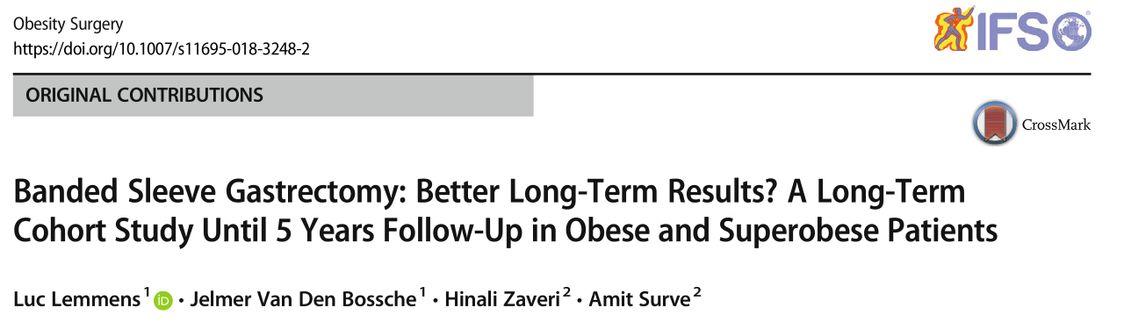
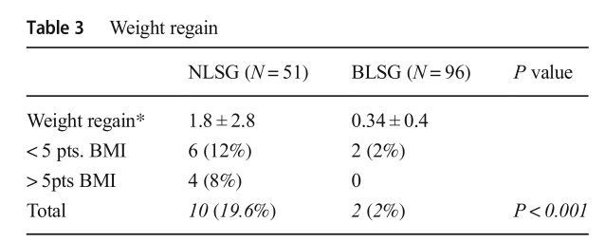
Banded sleeve: results

Slide 6
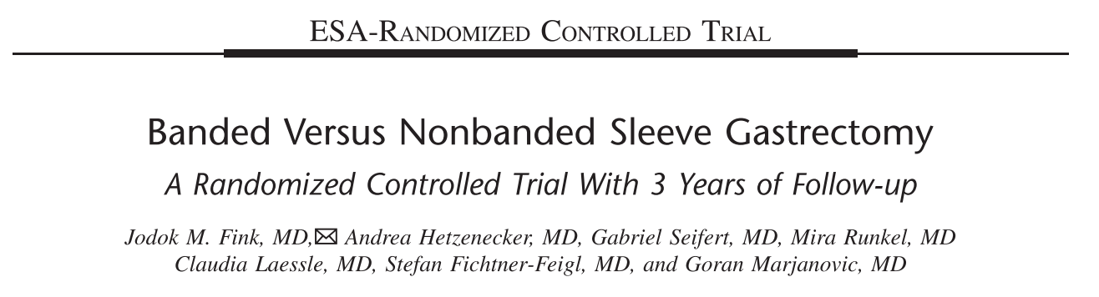
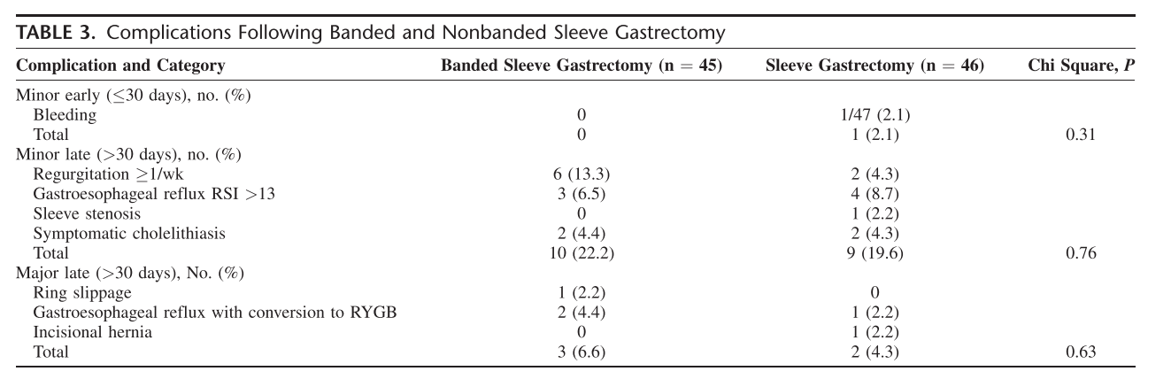
Banded sleeve: results
Adjusted %EWL 3 years after surgery was 62.3% (95% CI, 56.2–68.5) for SG and 73.9% (95% CI, 67.8–80.0) for BSG (P = 0.0073).
At 3 years, adjusted BAROS score was 1.5 points higher in BSG (BSG 6.44; SG 4.98; P = 0.0017).

Slide 7
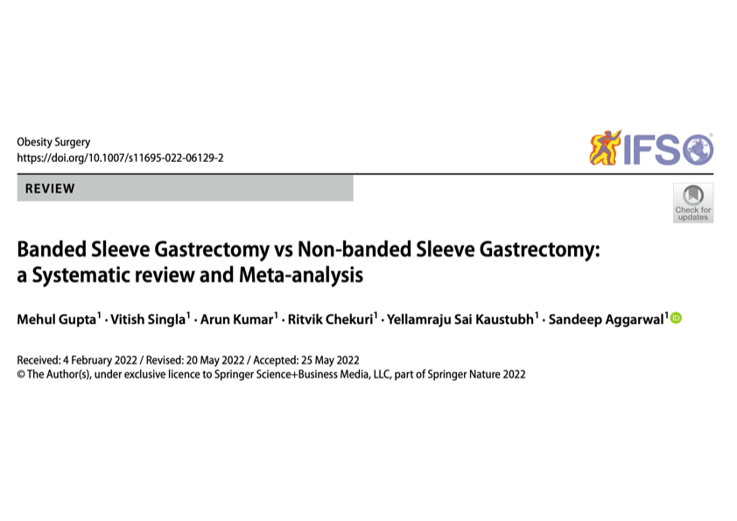

Slide 8
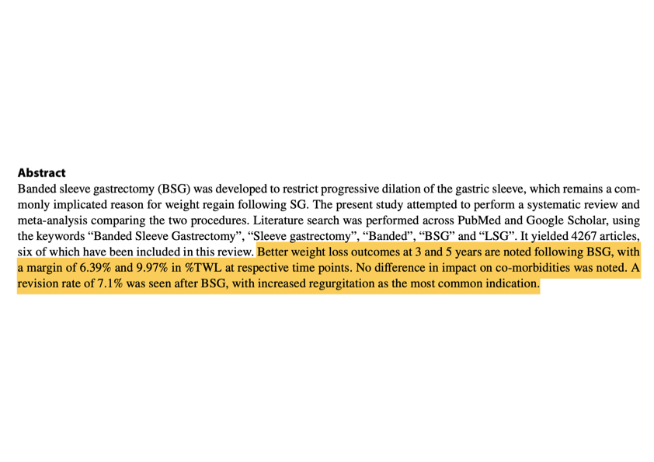

Slide 9
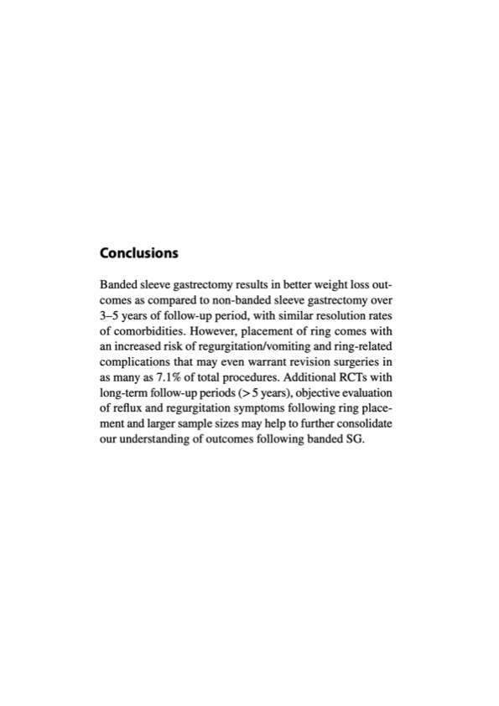

Slide 10
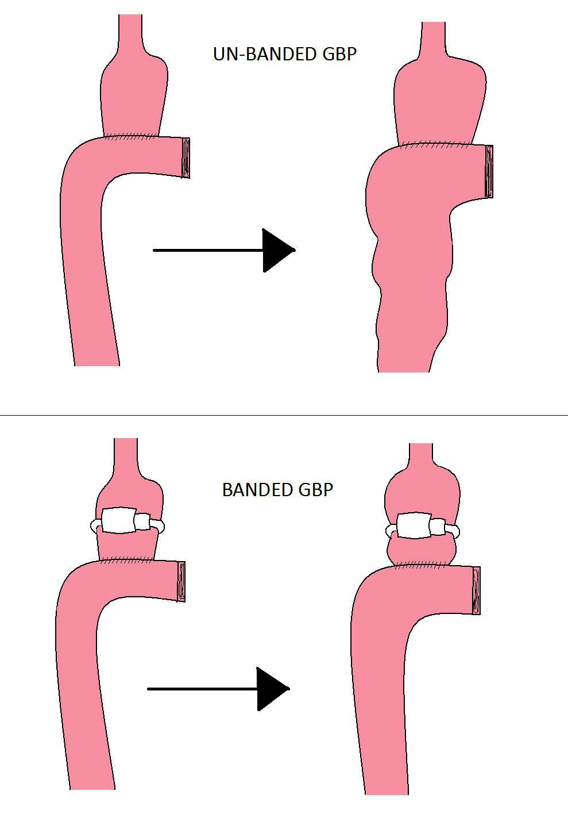
Banded RYGB: rationale
Incidence of weight regain was 17.6% (n = 2314/13,152; 95% CI 16.9–18.3).

Slide 11
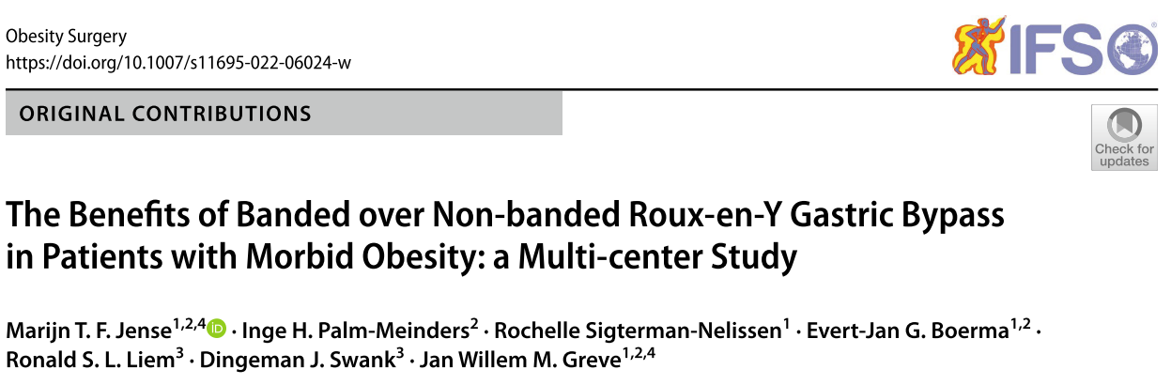
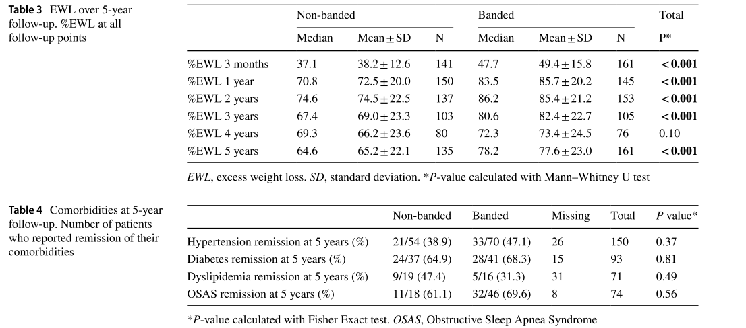
Banded RYGB: results

Slide 12
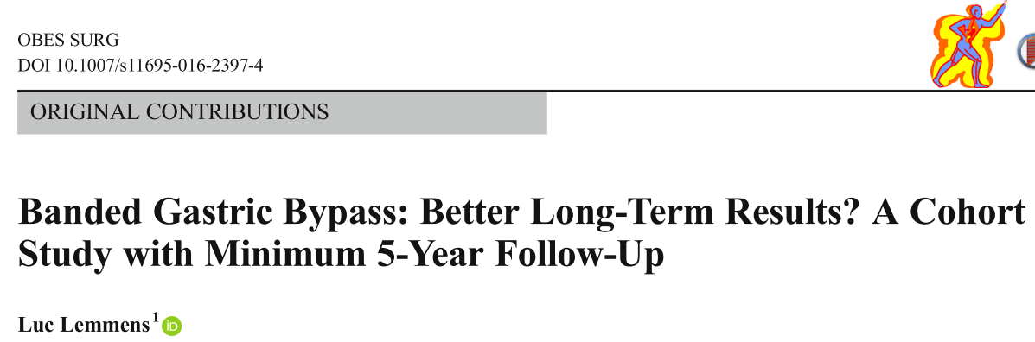
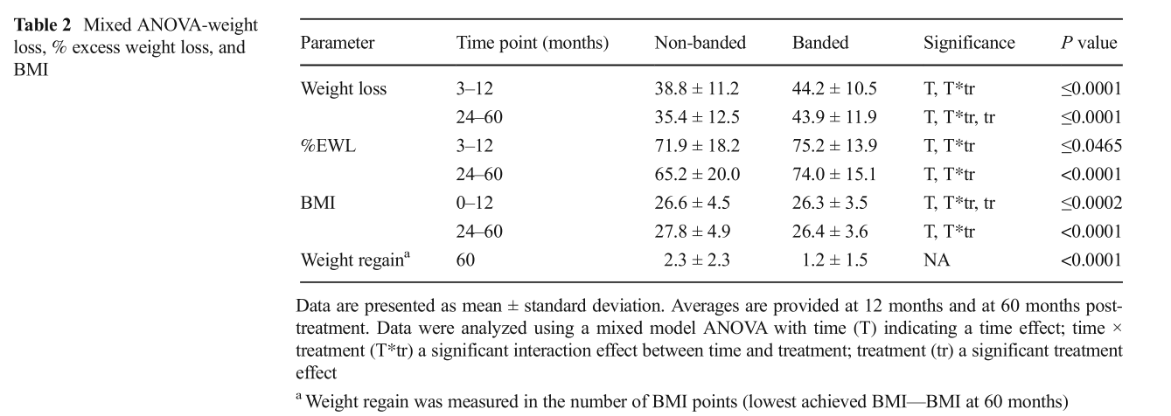
Banded RYGB: results

Slide 13
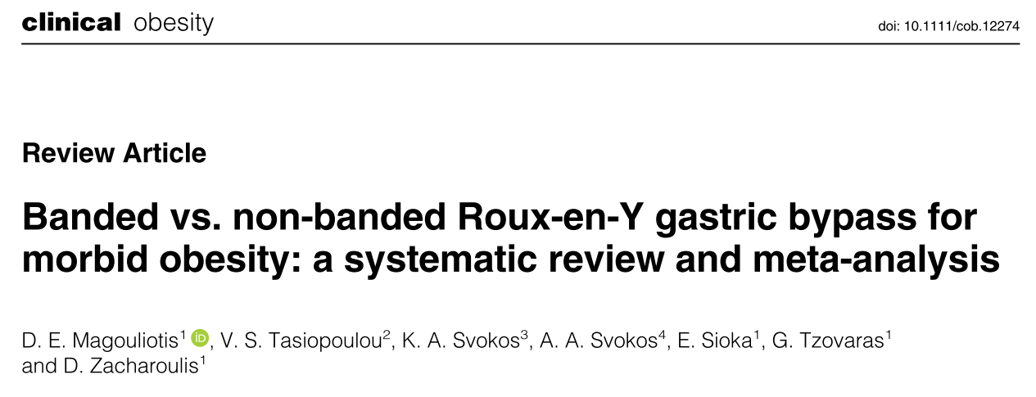
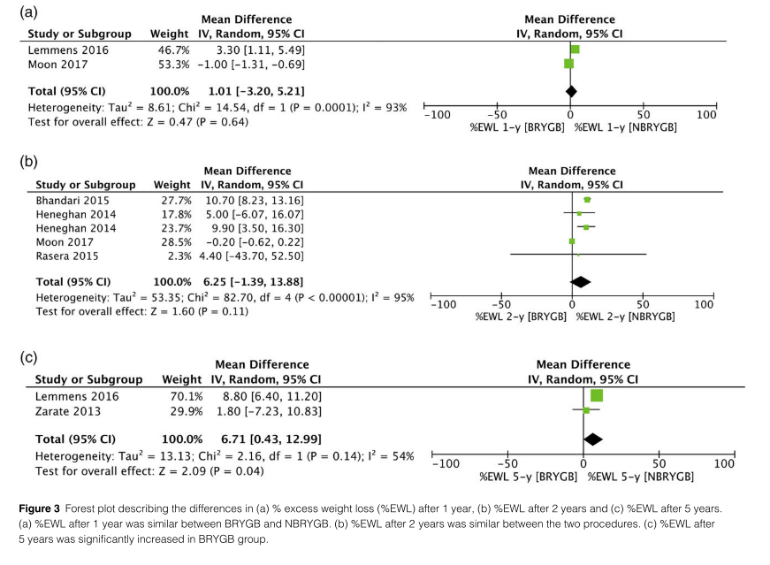
1 year
2 years
5 years
2018

Slide 14
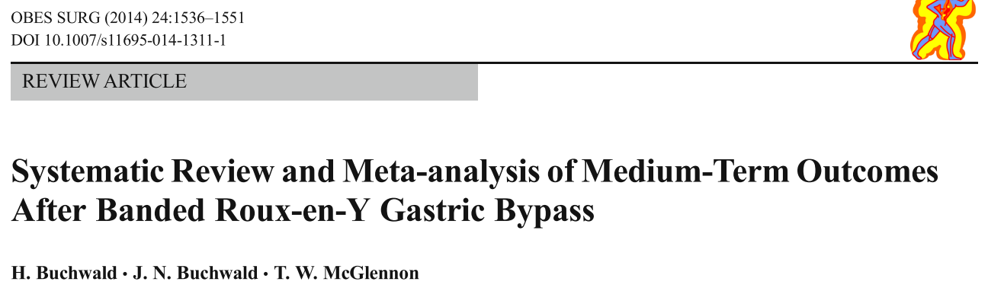
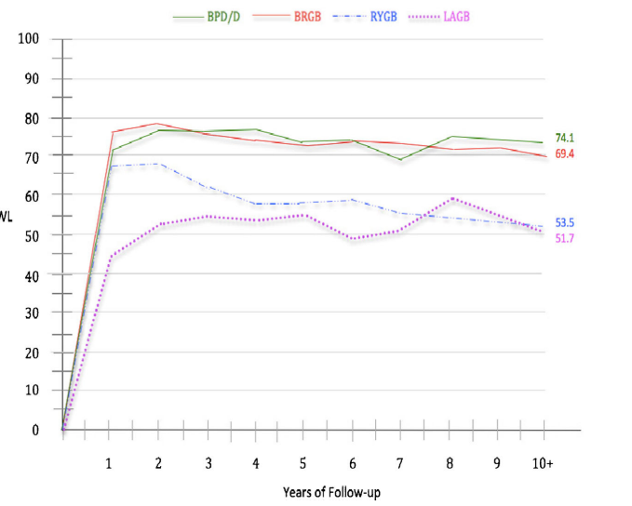
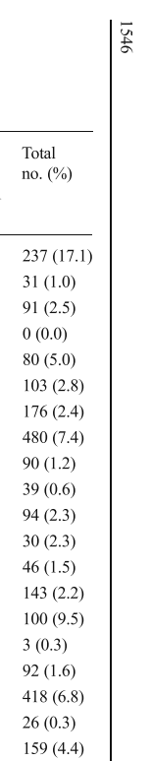
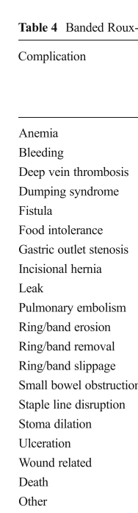
Five-year weighted mean EWL of 72.5 % (67.5, 77.4) was sustained at 10+ years (69.4 %; 58.9, 80.0).

Slide 15
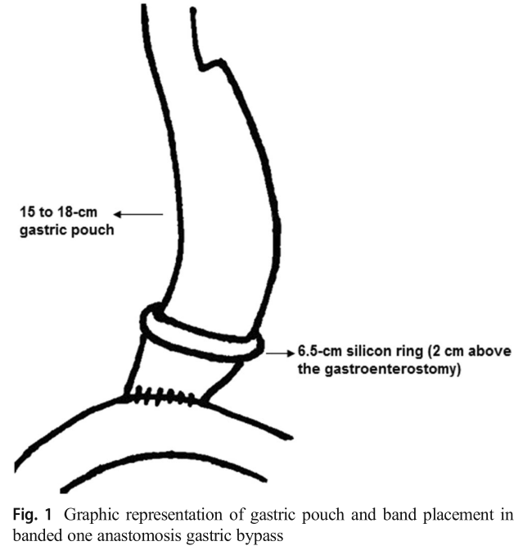
Banded OAGB: rationale
Incidence of weight regain was 17.6% (n = 2314/13,152; 95% CI 16.9–18.3).

Slide 16
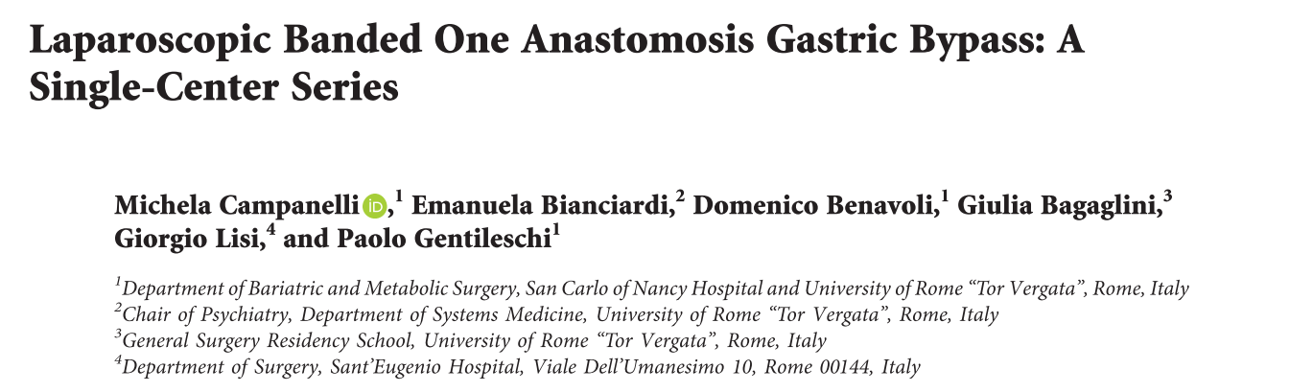
Banded OAGB: results
Median follow-up: 18 months (5–36).
No patient ring removal or conversion to Roux-en-Y gastric bypass.
Food intolerance/ vomiting was present in 1 patient (1.1%)
Bile reflux was present in 1 patient (1.1%)
No stomal ulcers were observed

Slide 17
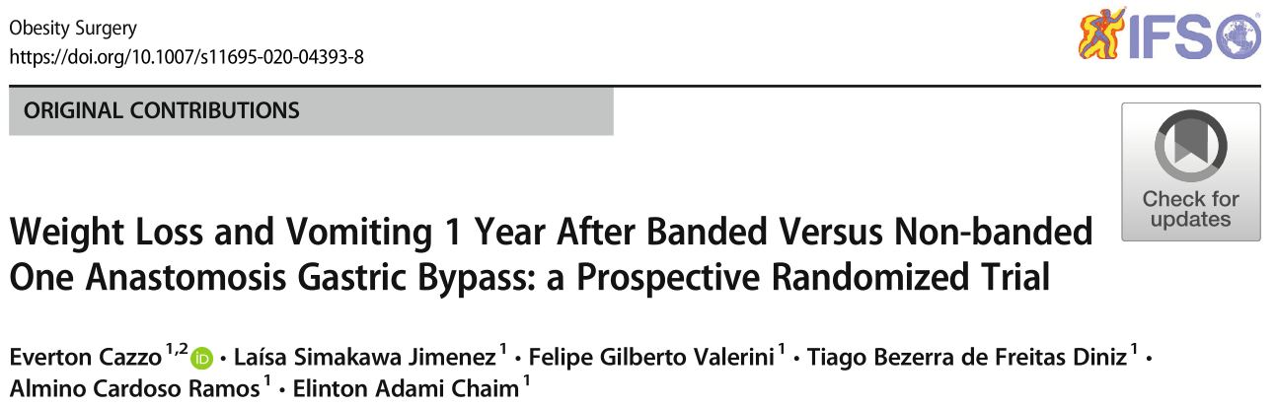
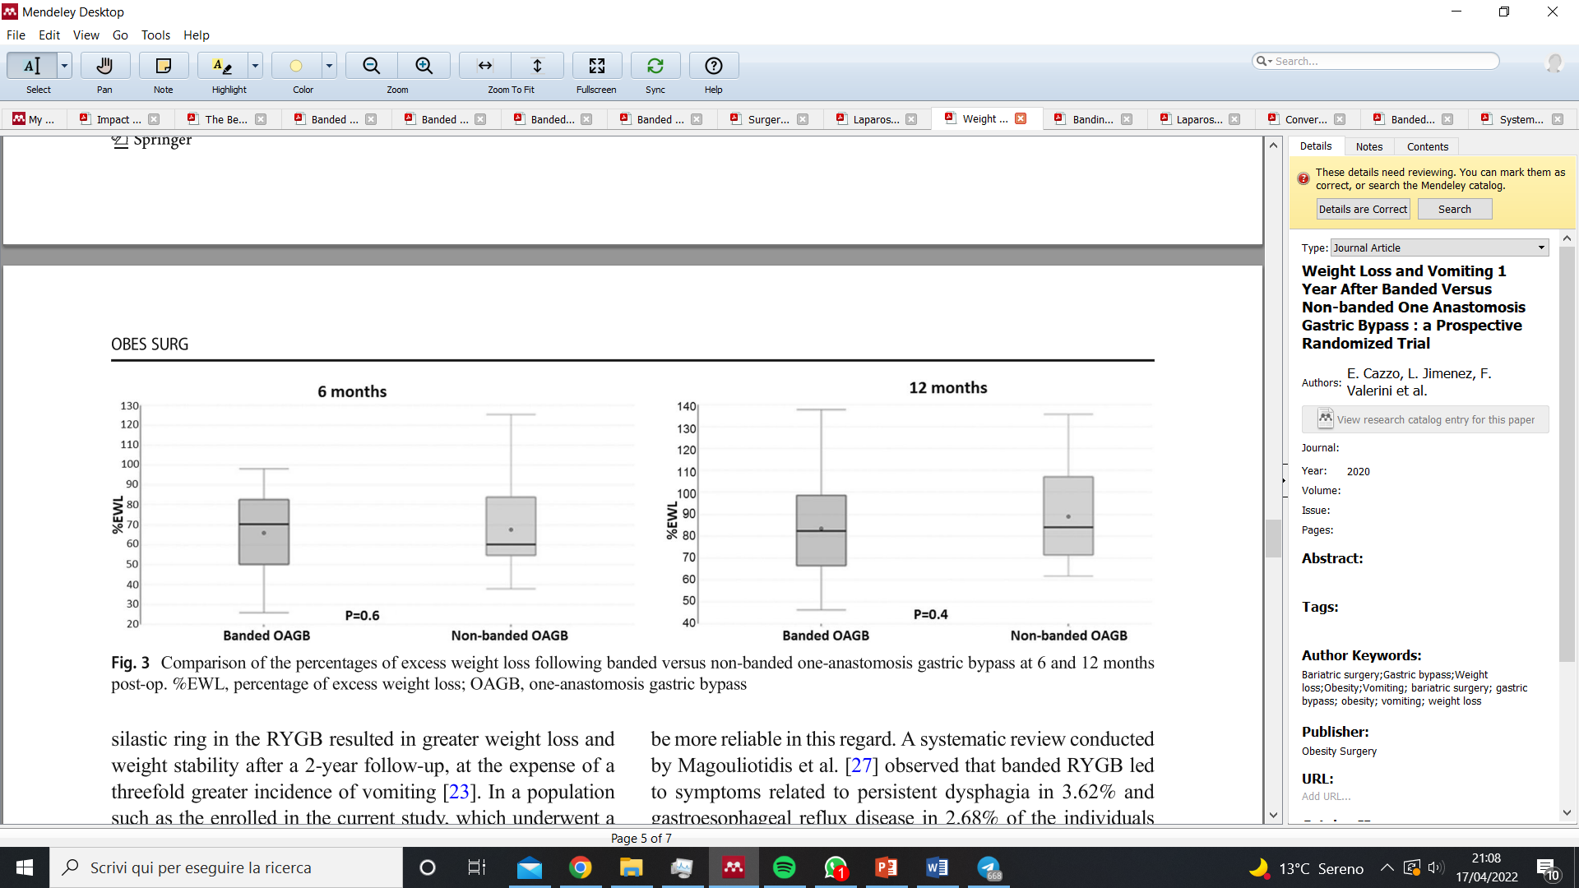
Banded OAGB: results

Slide 18
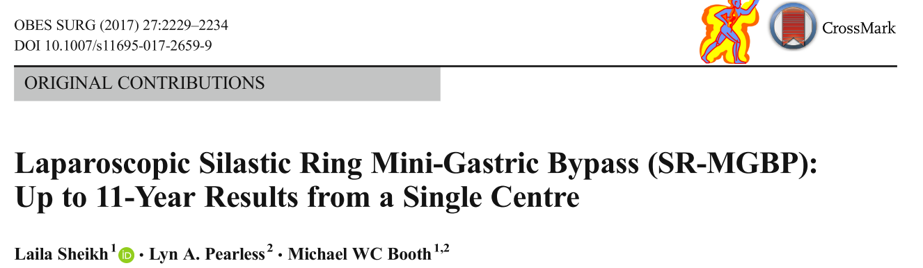
Banded OAGB: results
Mean percent excess weight loss (%EWL) at 11 years was 84.3%
3.6% had SR problems needing removal.
Two other patients had the SR changed to a bigger size and a further two had endoscopic removal ofthe SR for erosion.
The number of patients on anti-reflux medications increased from 5.1% to 44.6% at 11 years.

Slide 19
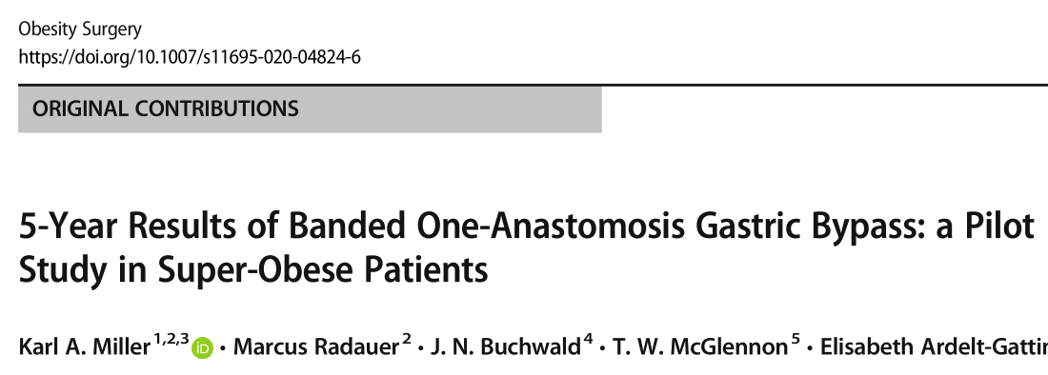
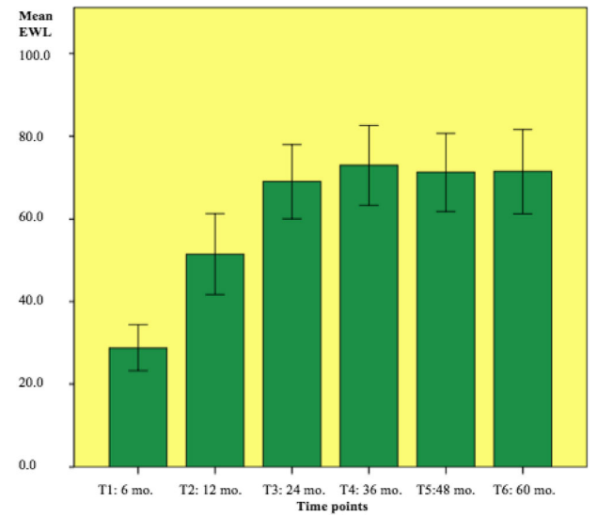
Banded OAGB: results
3 patients required band removal for:
-stasis esophagitis and recurrent vomiting
-1 hypoalbuminemia
-anemia
Five-year mean BMI was 31.2 ± 5.4, a BMI loss of25.9 (TWL 45.3 ± 7.5%; EWL 72.2 ± 12.8%).
Patient #6 = band explantation at 18 mo.; shortened afferent limb from 200 to 160 cm

Slide 20
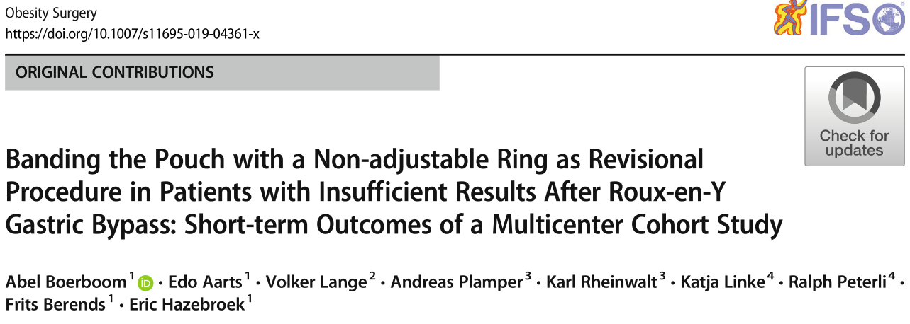
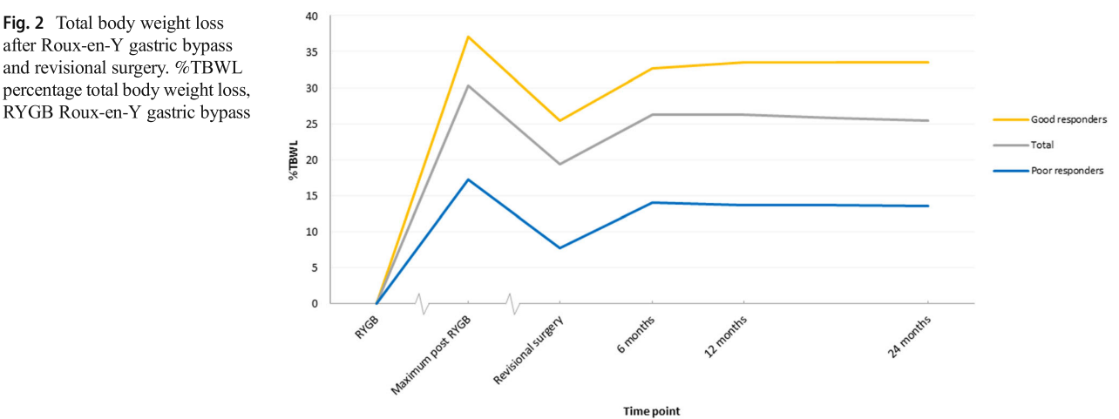
Re-do Surgery: Results

Slide 21
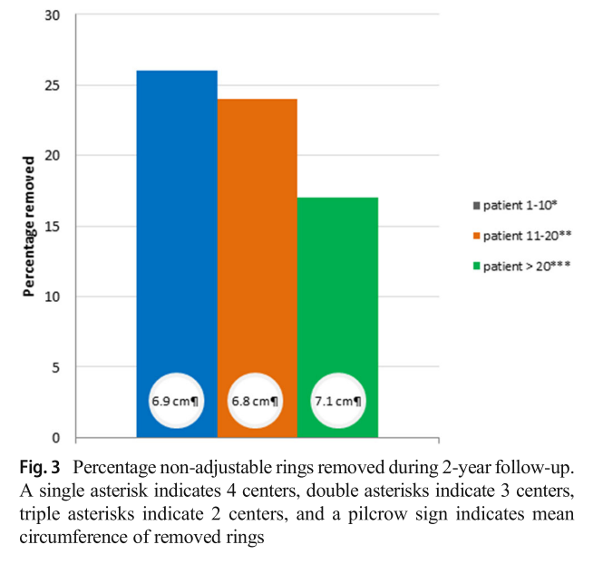
Re-do Surgery: Results
Eighteen (23%) rings were removed after a mean follow-up of 9 months and five (6%) were adjusted to a larger circumference.
The main reason for band removal or adjustment was dysphagia (n = 22).
This percentage decreased to 17% when expe- rience increased (> 20 procedures)

Slide 22
Technical Aspects
RETROGASTRIC TUNNEL
PARS FLACCIDA TECHNIQUE
PERIGASTRIC TECHNIQUE
ONE SIZE FITS ALL
MEDIALLY TO LATERAL STARTING 4 CM FROM THE EG JUNCTION

Slide 23
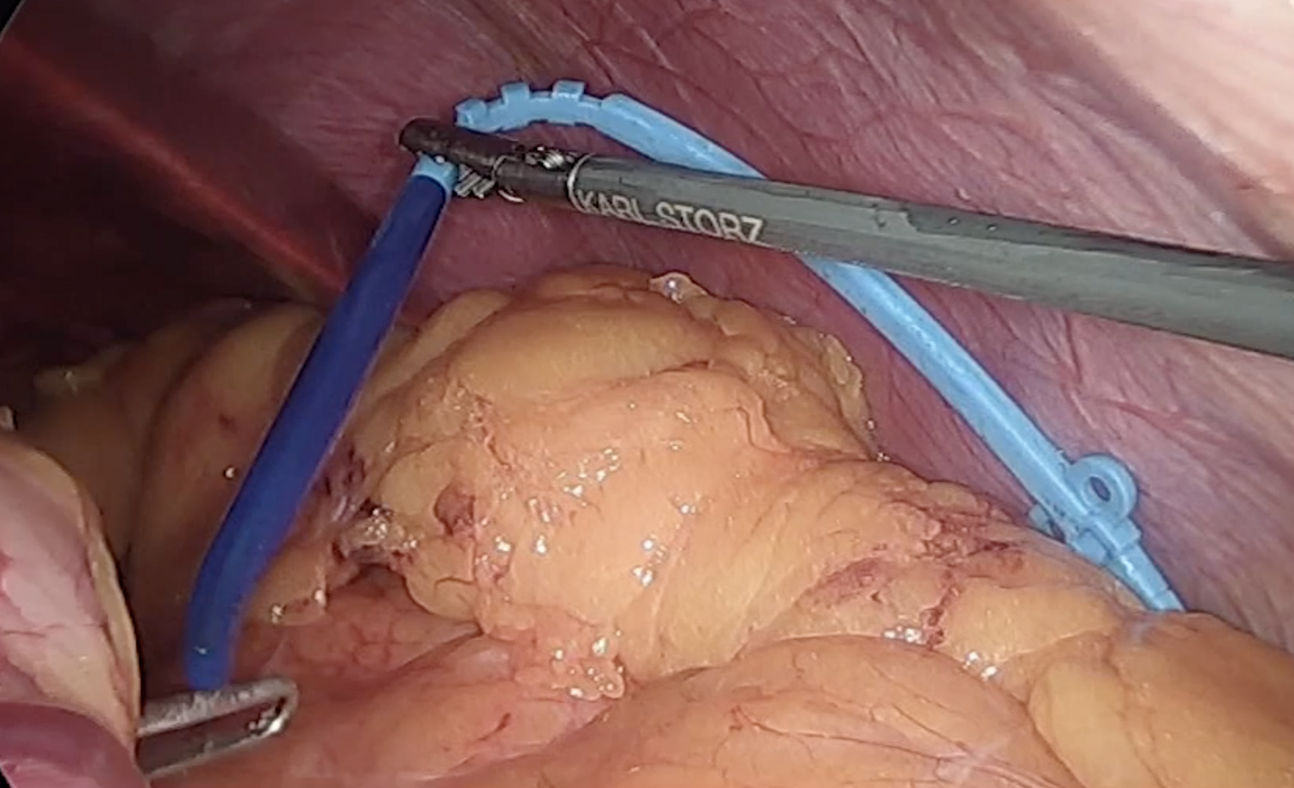
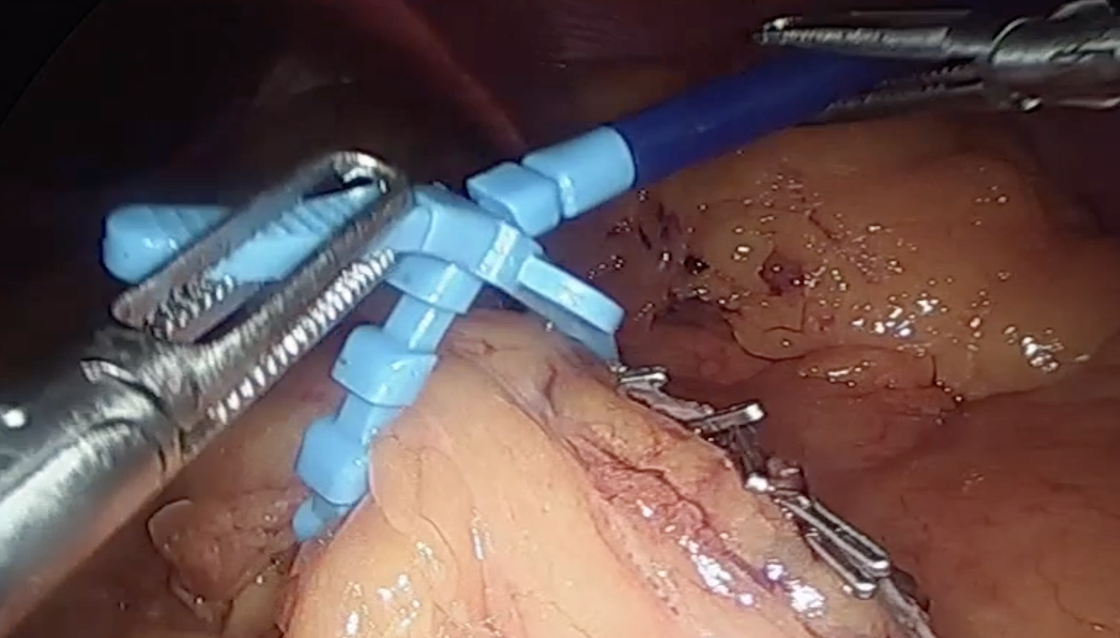
GRAB THE RING FROM THE HARD BLUE SIDE ANDD PULL IT OVER THE SLEEVE
CLOSE THE RING OVER THE BOUGIE (36 FR) AT THE FIRST STEP

Slide 24
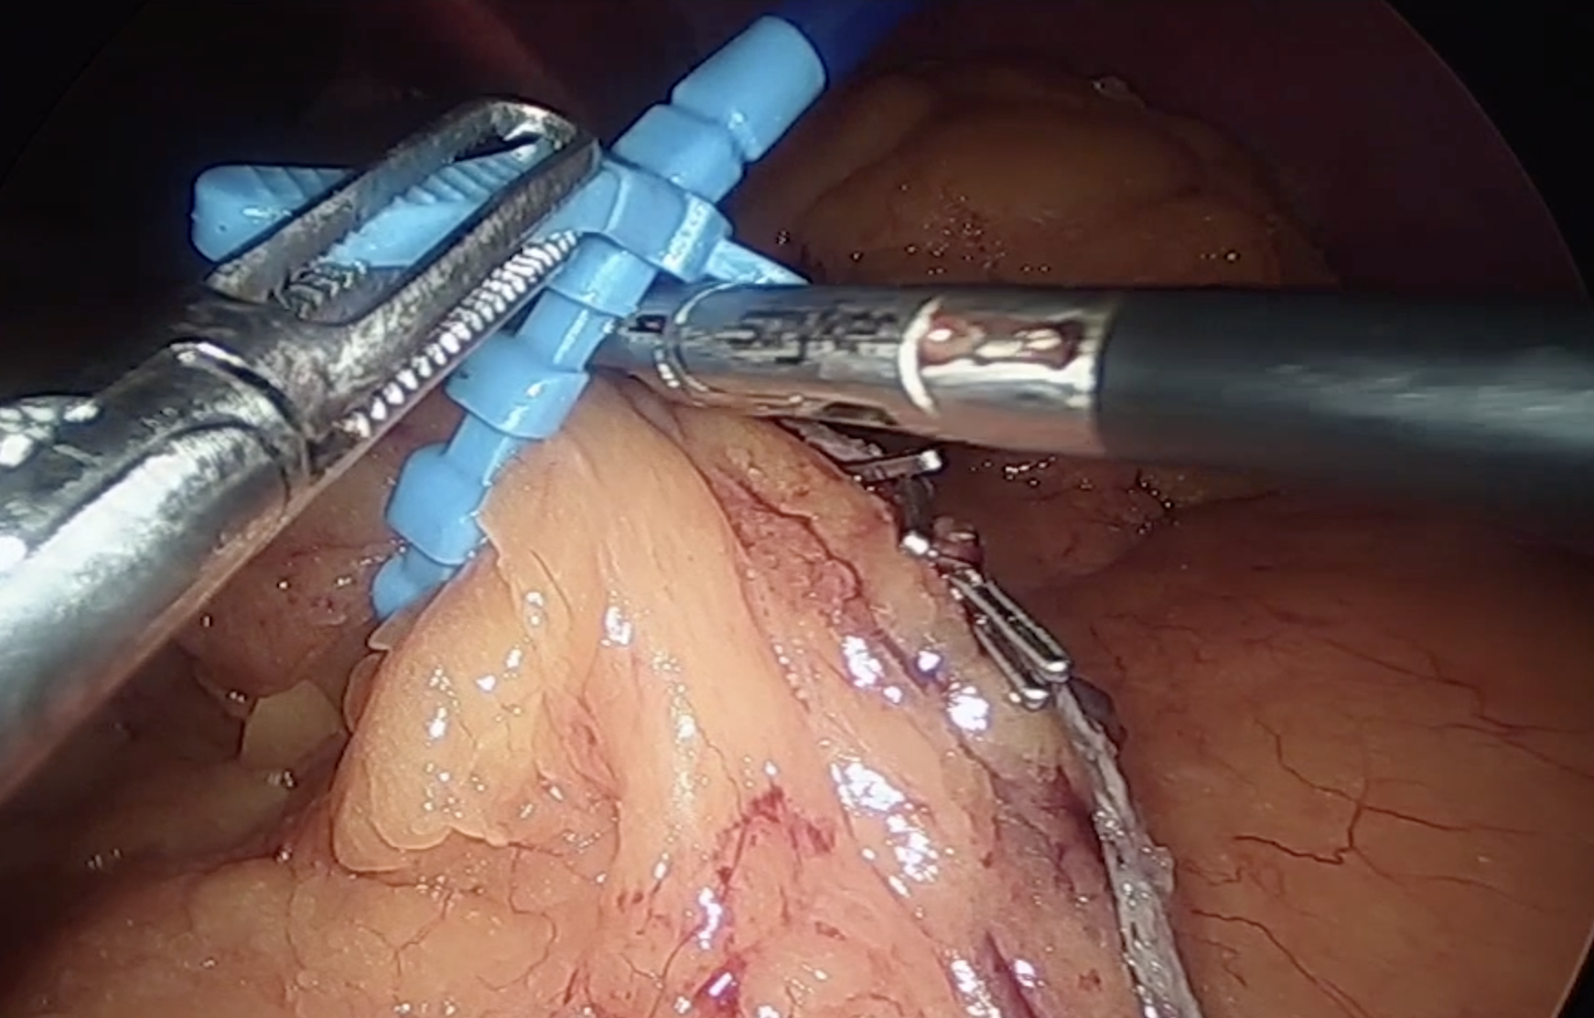
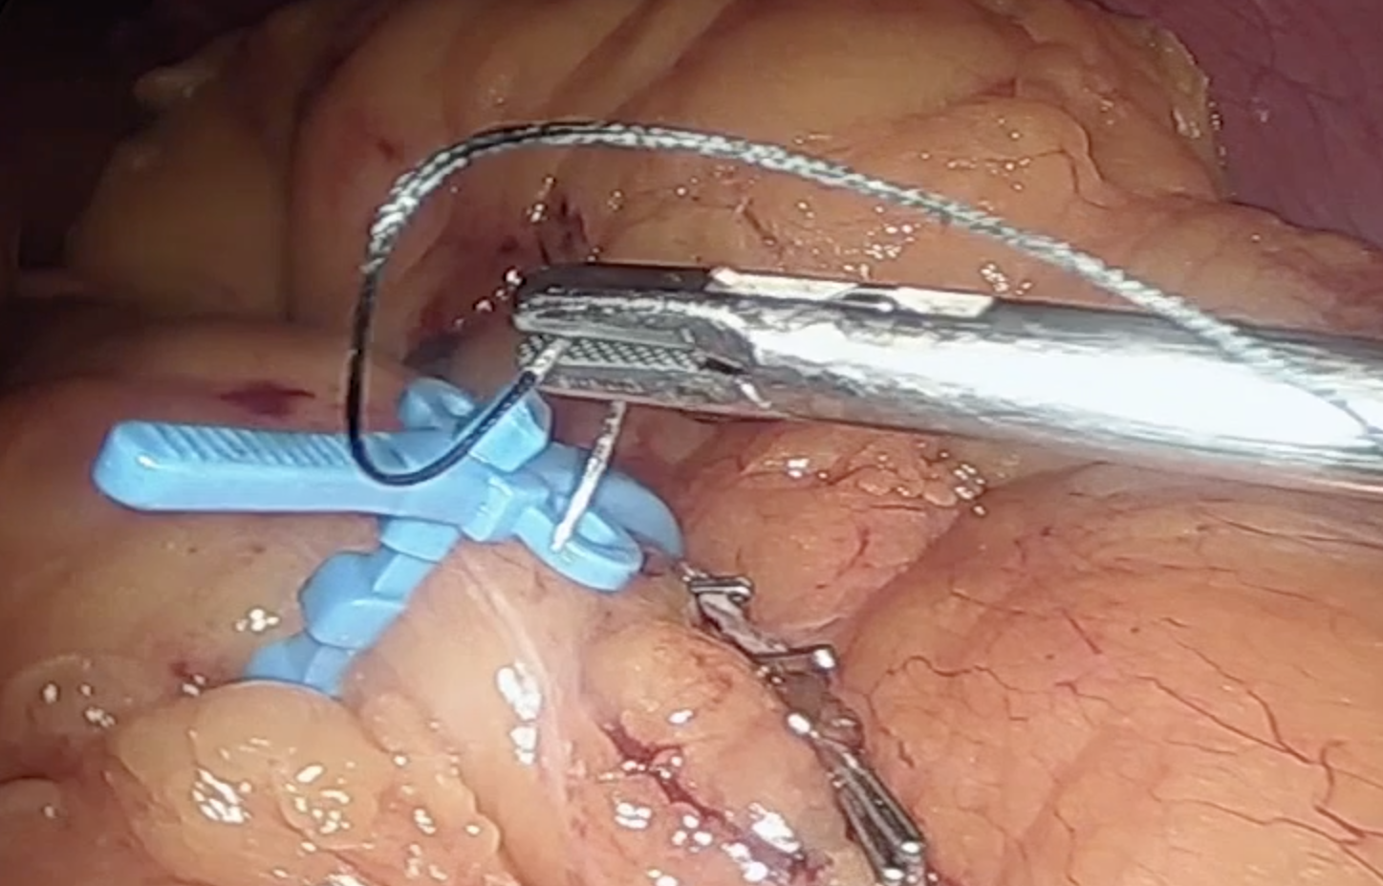
THE RING HAS TO BE LEFT IN PLACE IN A LOOSE FASHION (WE DON’T WANT TO CREATE A STRICTURE WICH COULD INCREASE PRESSURE AND THE GASTRIC LEAK INCIDENCE)
REMOVE THE BOUGIE AFTER METHYLENE BLUE TEST AND SECURE THE RING WITH TWO NON-ABSORBABLE SUTURES

Slide 25
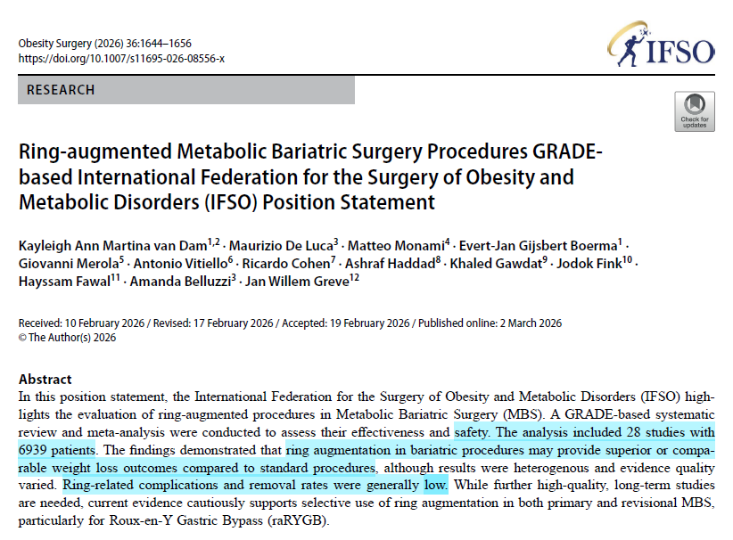
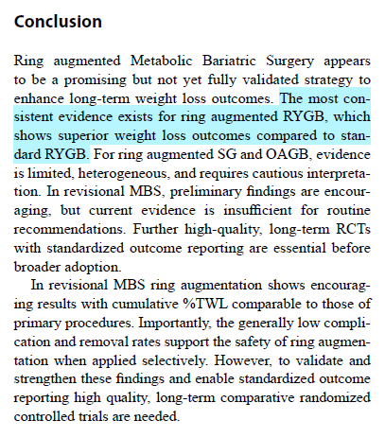
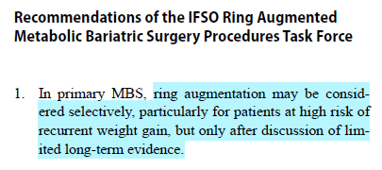
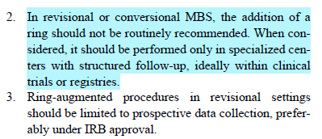
Ring-augmented Metabolic Bariatric Surgery

Slide 26
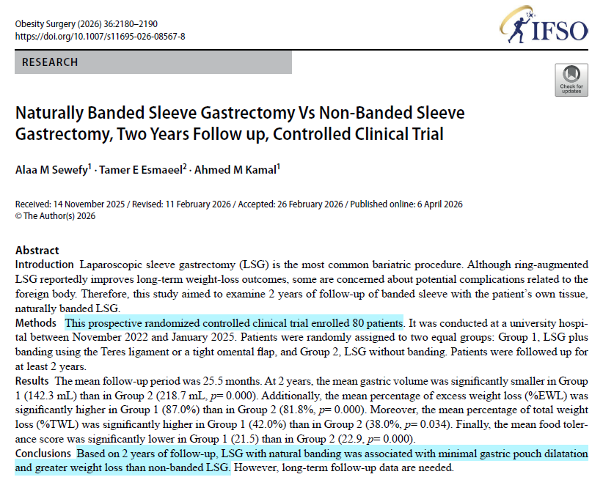
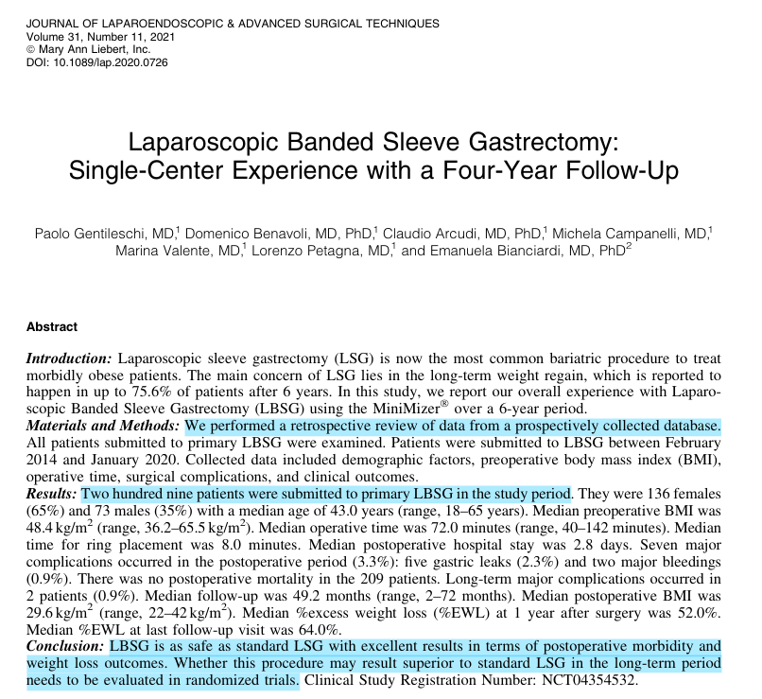
Banded Sleeve Gastrectomy

Slide 27
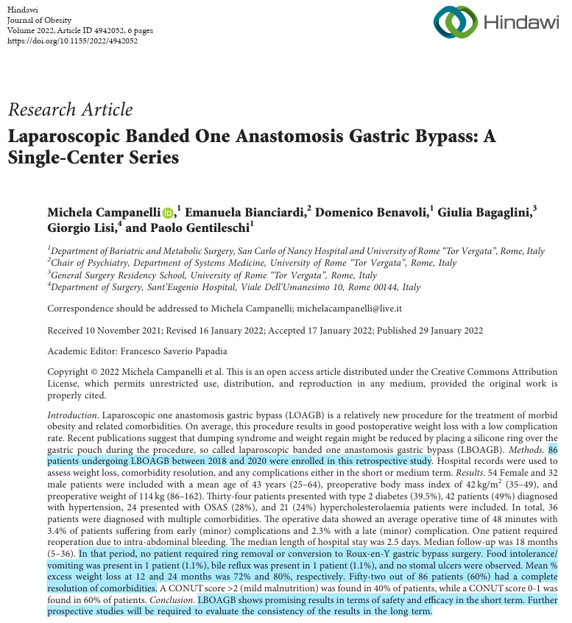
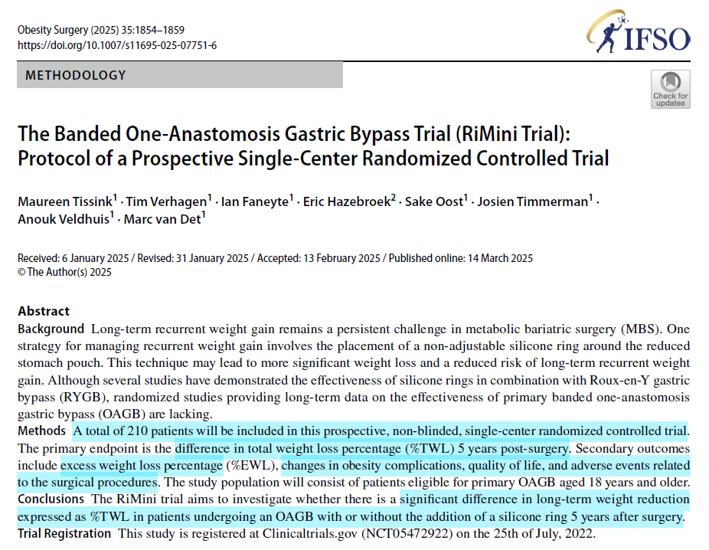
Banded One-Anastomosis Gastric Bypass

Slide 28
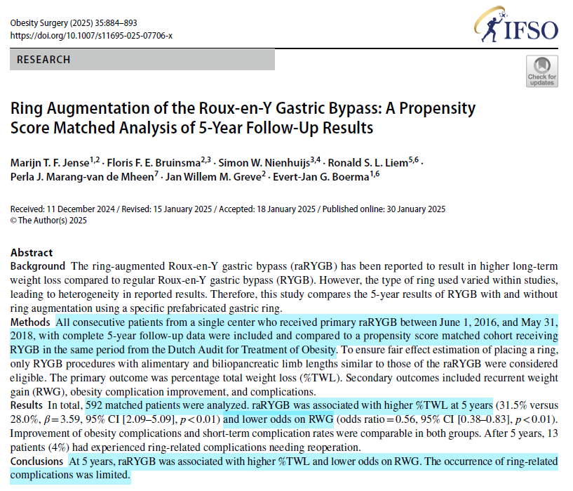
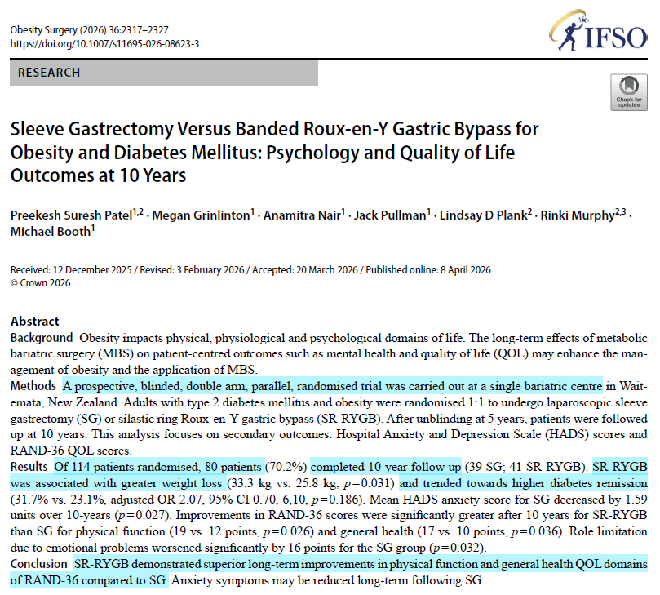
Ring-Augmented RYGB

Slide 29
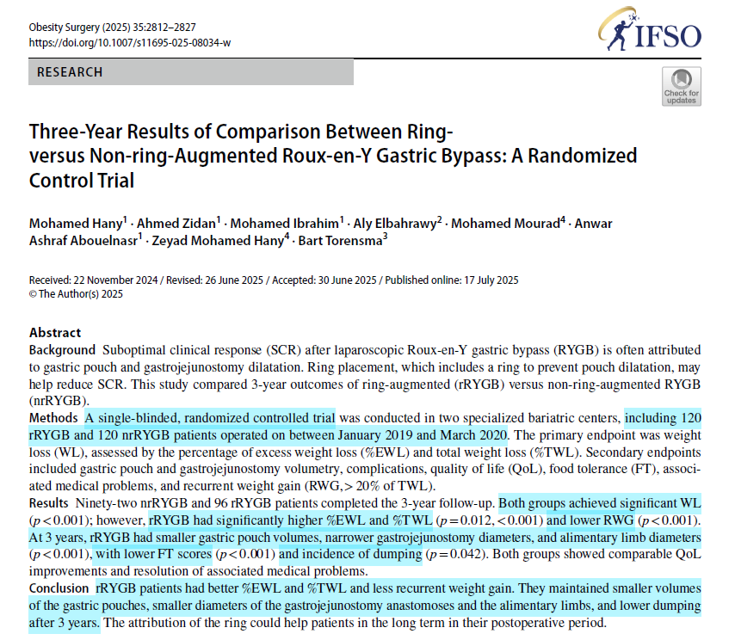

Ring-Augmented RYGB

Slide 30


Ring-Augmented RYGB

Slide 31


Ring-Augmented RYGB

Slide 32
Take-Home Message
Banded SG: - superior long-term %EWL, < weight re-gain and QoL.
- overall complication rate similar to SG.
- good option in the super-obese
Banded RYGB: - superior long-term %EWL and < weight re-gain.
- Overall complication rate similar to RYGB.
Banded OAGB: - appears safe.
- Currently little evidence: no long-term data. No RCTs.
Banded Re-do: - Good option
- Maybe in integrated approach/procedures

